Slide 1

Zomato Data Analysis
Study how restaurants provide online delivery compared to offline services?
Which types of restaurants are most favored by the general public?
What price range do couples prefer for dining out?
- Group A2 Members & Roles
706_Siddhi Bhoir
Data Architecture - Explore Dataset, Data cleaning, handling missing values, & merging.
707_Roshan Bhuvad
EDA Analyst - Statistical distributions & outlier detection.
708_Snehal Bolke
Feature Engineer - Creating new variables & correlation analysis.
709_Asiya Charolia
Modeler/Predictor - Running the core ML or statistical models.
710_Shantanu Chavan
Insights Lead - Model evaluation & R Markdown/Shiny report.

Slide 2
The Business Problem
Scenario Overview :
Food delivery platforms like Zomato operate in a highly competitive market where understanding customer dining behavior is critical for both platform growth and restaurant success. Restaurants must decide how to balance online delivery services with offline dining experiences while also aligning pricing and cuisine offerings with customer expectations.
The Pain Point :
Service Mode Performance
Do restaurants offering online delivery perform better than those relying primarily on offline dining in terms of ratings and popularity?
Customer Preference by Restaurant Type
Which types of restaurants (e.g., casual dining, quick service) attract the highest customer engagement and votes?
Price Sensitivity for Couples
What price range for two people is most preferred when dining out, especially among couples?
Why This Analysis Matters ?
Helps restaurants decide where to invest (delivery infrastructure vs dine-in).
Enables Zomato to recommend and promote restaurants more effectively.
Supports data-driven pricing strategies aligned with customer preferences.

Slide 3
Data Architecture
Data Source :
We have utilised the Zomato Restaurant Dataset obtained from Kaggle.
The dataset is provided in CSV format and contains restaurant-level information such as restaurant name, ratings, votes, online ordering availability, restaurant type, and approximate cost for two people etc.
Raw Data Characteristics :
Mixed data types, including numeric, categorical, and text fields.
Ratings stored in string format (e.g., "4.1/5") instead of numeric.
Missing values in key fields such as ratings and votes.
Inconsistent formatting that required preprocessing before analysis.
Cleaning & Preprocessing Strategy
Missing Value Handling
Rows with invalid or missing ratings were removed, and missing vote counts were identified to prevent distortion in popularity analysis.
colSums(is.na(df))
Data Type Standardization
Numeric columns such as ratings, votes, and approximate cost for two people were formatted correctly to ensure consistency across all analyses.
Rating Transformation
Converted ratings from "4.1/5" to numeric values for analysis.
df$rate <- str_remove(df$rate, "/5")
df$rate <- as.numeric(df$rate)

Slide 4
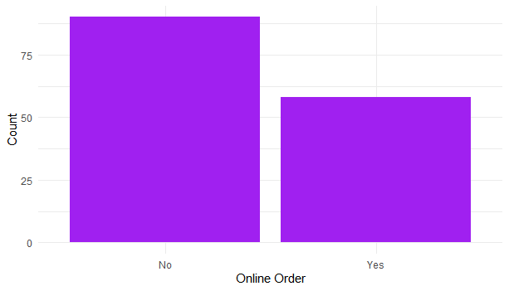
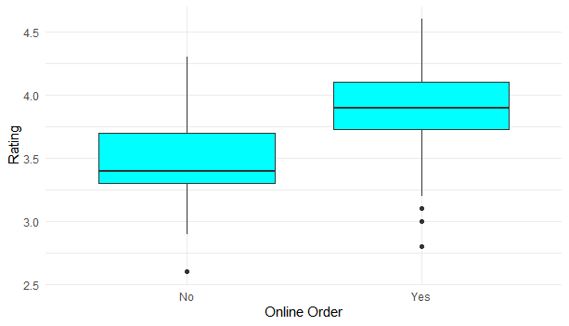
Exploratory Insights
Insight 1: Impact of Online Order vs Offline Order on Restaurant Performance
Visualization Used :
Bar Chart : Comparison of restaurants offering online ordering (Yes) vs offline-only (No) .
Boxplot : Comparison of customer ratings for online-order and offline-only restaurants.
Key Observations
This suggests that a majority of the restaurants do not accept online orders.
Restaurants with online ordering have higher median ratings.
Offline-only restaurants have lower median ratings and more variability.
Online-order restaurants show more consistent customer ratings.
Business Insight
Customers show a clear preference for restaurants that support online delivery, suggesting that online availability positively influences both customer reach and perceived quality.

Slide 5
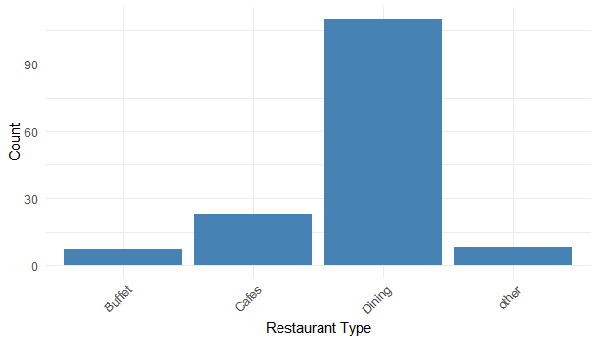
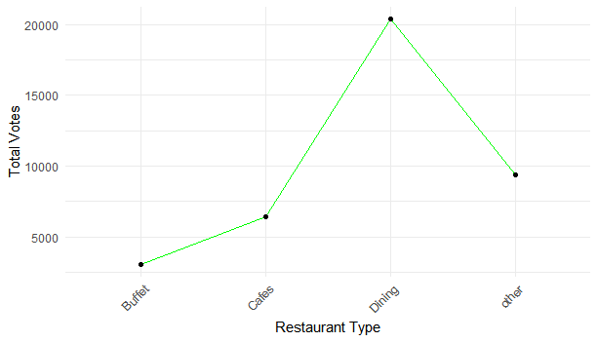
Exploratory Insights
Insight 2: Preferred Restaurant Type
Visualization Used :
Bar Chart – Counts of restaurants by type (Buffet, Cafes, Dining, Other) .
Line Chart – Total votes received by restaurants of each type.
Key Observations
Most restaurants are Dining, followed by Cafes; Buffet and Other are few.
Dining restaurants get the most votes, showing high popularity.
Cafes have moderate popularity, Buffet and Other types have low presence and engagement.
Business Insight
Customers clearly prefer Dining-type restaurants, both in terms of availability and popularity.
Restaurants could focus on Dining-style offerings or enhance their online visibility to attract more customers.

Slide 6
Feature Strategy
New Variables / Features Used :
Votes (Popularity Indicator)
Represents how many users have rated a restaurant.
Higher votes usually mean higher customer trust and popularity of a restaurant.
df$votes_by_type
2. Approx Cost for Two (Pricing Preference)
Shows the average spending for two people
Helps understand affordability and couple dining behavior
df$approx_cost_for_two_people
Expected Impact on the Model
Understand Zomato customer behavior better.
Predict restaurant ratings more accurately.
Identify popular yet affordable restaurants.
Capture real-world factors affecting restaurant success.
Why These Features Were Important
Ratings alone are not enough to judge restaurant performance.
Votes explain popularity.
Cost for two explains customer affordability.
Restaurant type explains dining preferences.

Slide 7
Modeling Approach
Linear Regression Model
Why This Model?
01
Interpretability
Linear Regression clearly explains how each factor (votes, cost) influences restaurant ratings, making results easy to understand for zomato users.
02
Suitable for Numeric Prediction
Restaurant ratings are continuous numeric values, making Linear Regression a natural and effective choice.
03
Baseline & Comparison Model
The model serves as a strong baseline before using complex algorithms like Random Forest.
Alternative Considered:
Linear Regression was chosen over Random Forest because it provides clear and easily interpretable insights into how factors like votes and cost affect restaurant ratings.
Random Forest, although powerful, acts as a black-box model and was avoided to keep the analysis simple and business-friendly.

Slide 8
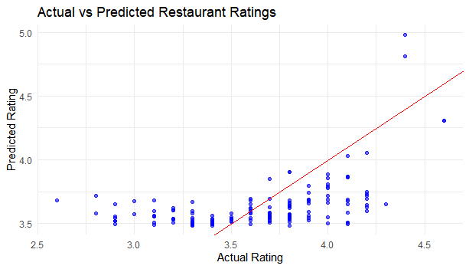
Model Evaluation
Evaluation Metric Used:
RMSE (Root Mean Square Error)
RMSE (Root Mean Square Error) was used to evaluate the performance of the Linear Regression model.
The model was tested on unseen data to compare predicted restaurant ratings with actual ratings.
RMSE measures the average prediction error in rating values
Did the Model Work?
The Linear Regression model produced a reasonably low RMSE, indicating acceptable prediction accuracy.
Predictions followed the overall trend of actual ratings, showing the model learned meaningful relationships.
Conclusion
The model performs well as a baseline regression model
It effectively explains how votes and pricing influence restaurant ratings, though more complex models could further improve accuracy

Slide 9
The "So What?"
Actionable Business Recommendations
1. Expand Online Ordering Presence
Restaurants offering online delivery consistently show higher and more stable ratings.
Action: Zomato should encourage offline-only restaurants to adopt online ordering through incentives and onboarding support.
2. Promote Popular Restaurant Types Strategically
Certain restaurant types receive higher engagement and votes from customers.
Action: Invest in menu optimization and marketing for these popular types to attract more customers.
3. Pricing Strategy Adjustment
Most customers prefer a moderate cost range for dining out as couples.
Action: Adjust pricing strategies to balance affordability and perceived value, ensuring competitive positioning in the market.
Business Value
Helps Zomato optimize restaurant listings and improve user experience.
These actions can increase customer retention, improve restaurant visibility, and boost overall platform revenue.

Slide 10
Technical Reflection
R Libraries Used
dplyr – Efficient data manipulation (filtering, grouping, summarizing).
ggplot2 – Powerful data visualization for insights (bar charts, boxplots, histograms, heatmaps).
stringr – Cleaning and formatting text data (e.g., ratings).
reshape2 – Creating heatmaps for visualizing matrices and comparisons.
Biggest Coding Challenges
Cleaning inconsistent rating formats (e.g., “4.1/5” ).
Handling missing or null values in multiple columns.
Visualizing categorical data clearly for meaningful interpretation.
How We Overcame It
Used string manipulation and type conversion functions in R
Performed systematic missing value checks before analysis
Key Takeaway
Overcoming these challenges helped us prepare clean, reliable data and create visualizations that effectively communicate insights.

Slide 11

THANK YOU !
GitHub Repository:
https://github.com/asiya142005/DataScience_Project_Zomato_Data_Analysis

